Slide 1
Data Science Engineering Methods and Tools Lecture 6
Northeastern University
College of Engineering
Multidisciplinary Graduate Engineering Department
INFO 6105 – Fall 2025
Instructor: Abdolreza Mosaddegh

Slide 2
Curse-of-Dimensionality
Typically, most of datasets are high in dimensions (many features)
In high dimensional data, distances between data points get larger.
Without many instances (proportional to number of features), distance measure becomes less reliable
Prediction accuracy can quickly degrade when number of attributes grows.
Pregnancies | Glucose | BloodPressure | SkinThickness | Insulin | BMI | DiabetesPedigreeFunction | Age | Outcome
6 | 148 | 72 | 35 | 0 | 33.6 | 0.627 | 50 | 1
1 | 85 | 66 | 29 | 0 | 26.6 | 0.351 | 31 | 0
8 | 183 | 64 | 0 | 0 | 23.3 | 0.672 | 32 | 1
1 | 89 | 66 | 23 | 94 | 28.1 | 0.167 | 21 | 0
0 | 137 | 40 | 35 | 168 | 43.1 | 2.288 | 33 | 1
5 | 116 | 74 | 0 | 0 | 25.6 | 0.201 | 30 | 0
Increasing the number of features will not always improve classification accuracy.

Slide 3
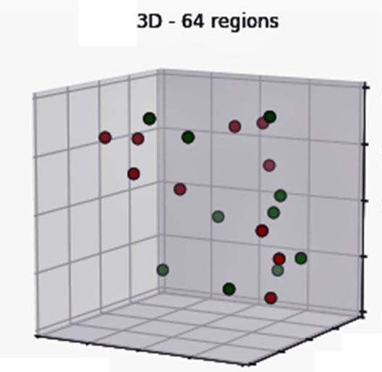
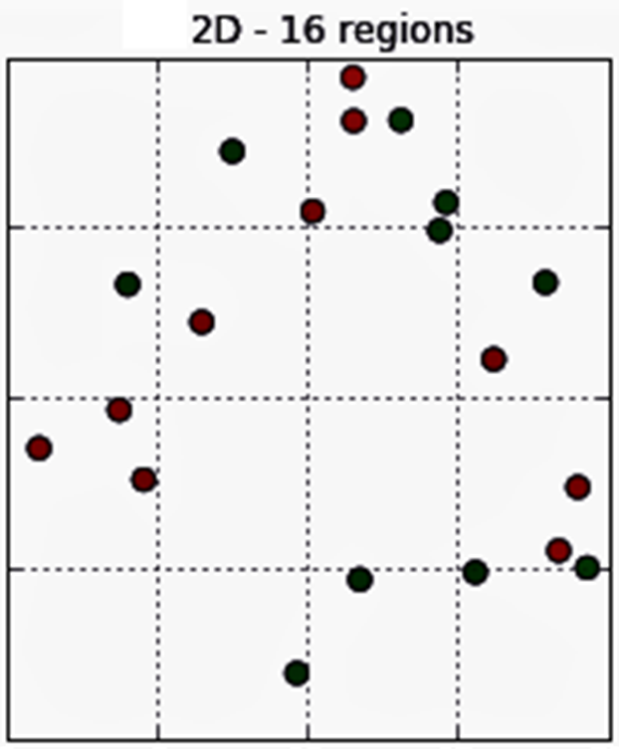
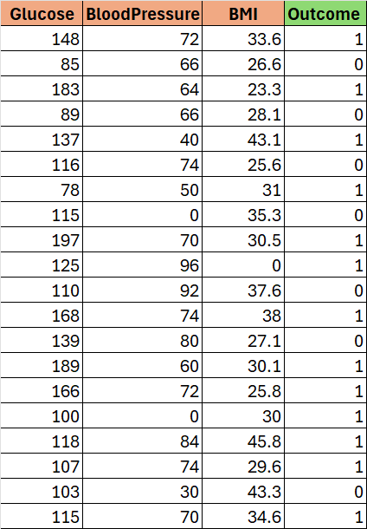
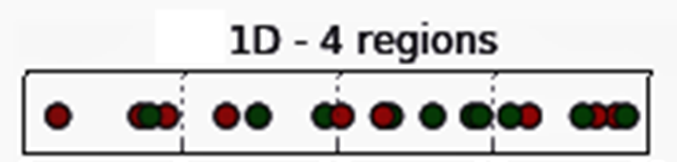
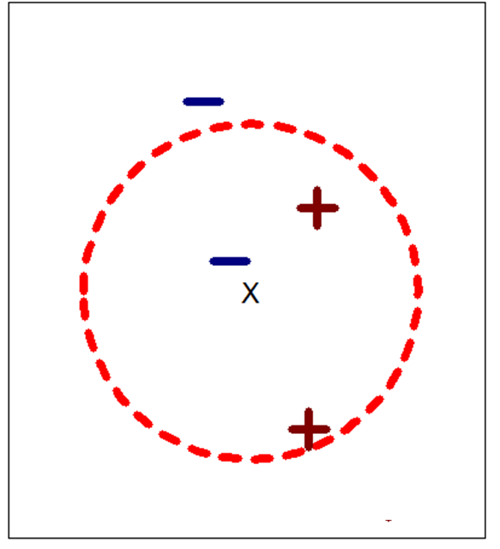
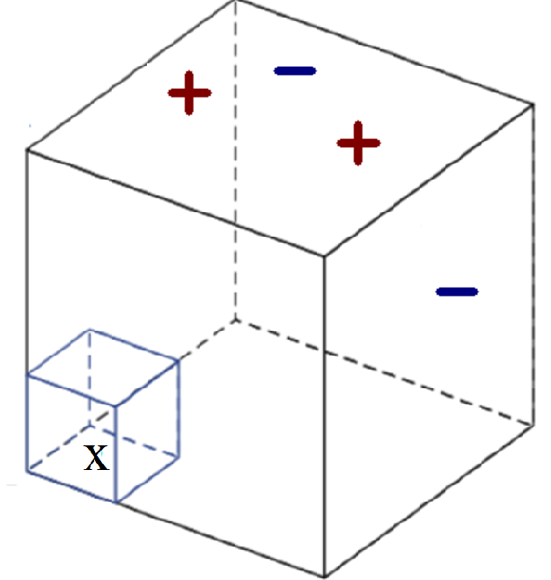
Curse-of-Dimensionality - Example
20 data points
High BMI
Low BMI
Low BMI High BMI
Low Glucose High Glucose
Low Glucose High Glucose
Low Glucose High Glucose
Low BP High BP
As dimensionality grows, fewer observations per region and less reliable results
Solutions:
More training data
Less features
3NN
3NN

Slide 4
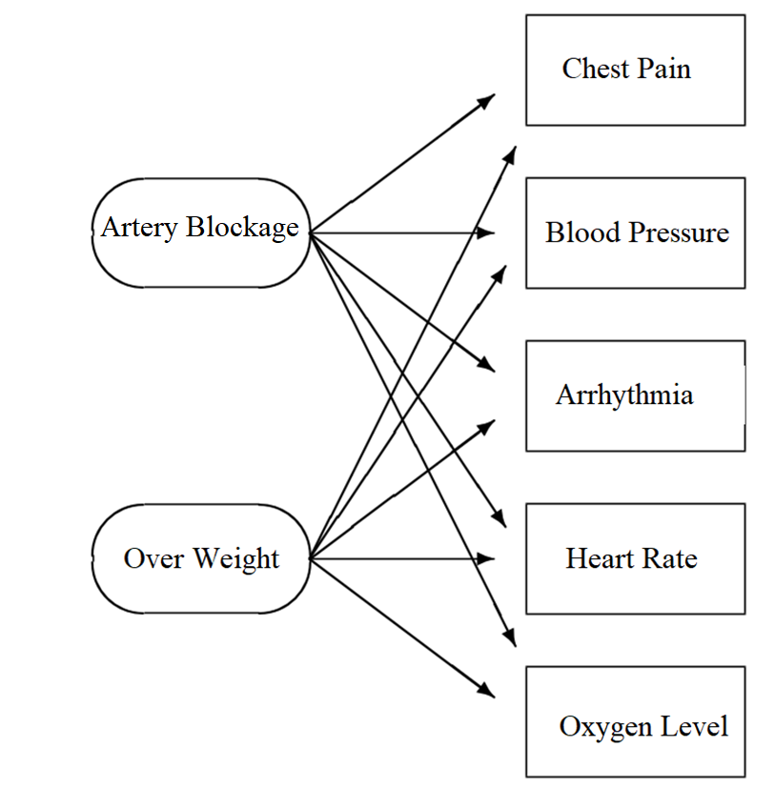
Solution: Dimensionality Reduction
Reduce the number of dimensions (features):
Avoid curse of dimensionality
Remove irrelevant features for prediction of output (not informative)
Intrinsic dimensionality may be smaller than the number of features (some hidden variables can represent many observer variables)
In some datasets there are weak correlations between some features with the class that is not general (risk of overfitting)
To visualize high dimensional data using 2/3 dimensions
Reducing computational costs

Slide 5
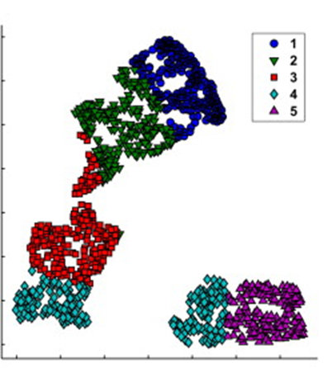
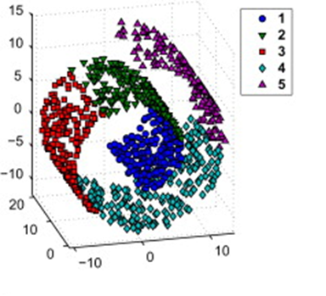
Dimensionality Reduction - Objectives
Two main objectives:
Choose an optimum set of features with a lower dimensionality to improve classification accuracy (classification-driven) → To avoid C.D., irrelevant features, and overfitting
Choose an optimum set of features with a lower dimensionality represent original information efficiently (information-driven) → For visualization and hidden factors
Improving Classification
Preserving Information
Desired
Dimensions
Problem: Needs methods to reduce dimensions based on these objectives

Slide 6
Dimensionality Reduction Methods
Two main approaches of dimensionality reduction:
Feature selection: chooses a subset of the original features.
Feature extraction: creates a new set of features by transformation of the original features
Transformation could be linear or non-linear
subset of features
K<D
Linear transformations are more common because they are more interpretable.

Slide 7
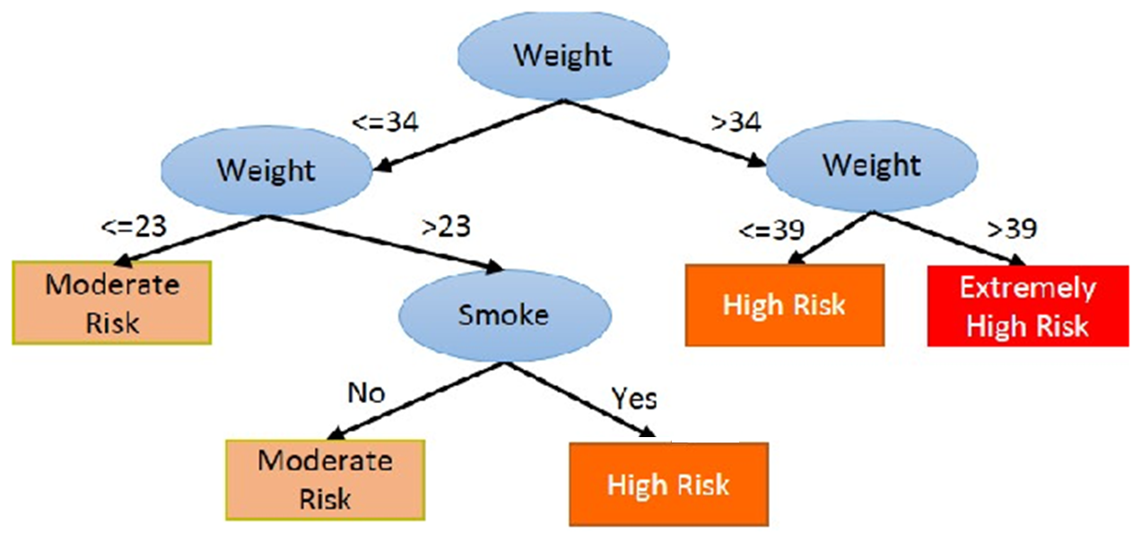
Feature Selection Advantages
1- FS provides more interpretable features
Transformation creates new features with unknown meaning which is not easy to interpret. This is more important in white-box models.
2- Some features may not be numeric
Sometimes it is complex to transform a mix of variable types (including nominal variables)

Slide 8
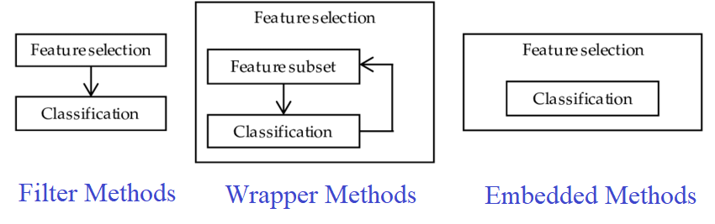
Feature Selection
Feature selection is an optimization problem (optimizing the objective function):
In feature selection a feature subset is evaluated against an objective function (criterion)
There are three main evaluation strategies for feature Selection:
Filter methods
Wrapper methods
Embedded methods
Note: Feature selection can also be done by knowledge of subject matter experts.

Slide 9
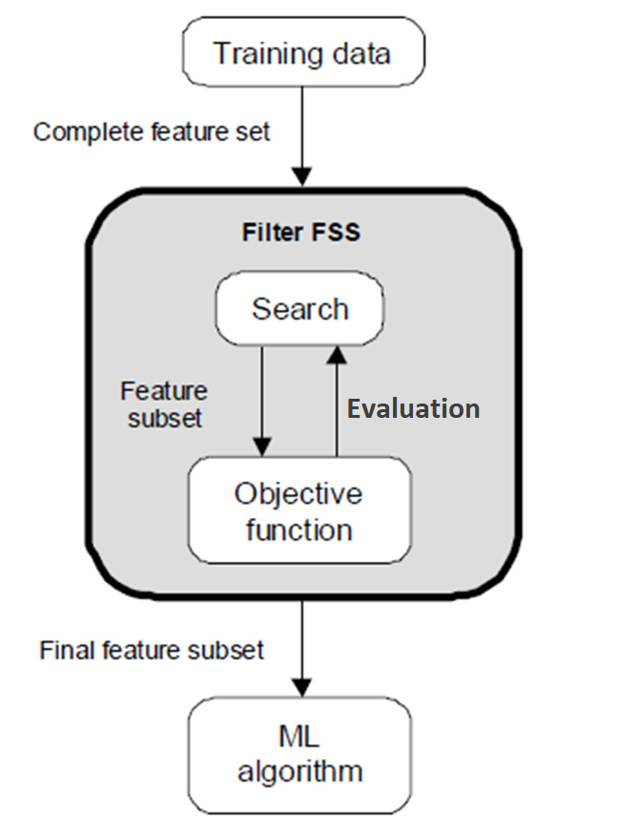
Evaluation Strategies – Filter Methods
Filters work independent of any particular learning algorithm (scores of features are independent of the ML model )
Filters seek a subset of features which optimize objective function (e.g., information content, dependence, etc.)
Filter method can score a subset of features together
Typically, try to find the smallest size where adding more features does not improve objective function significantly.
Sometimes number of features is predefined by user

Slide 10
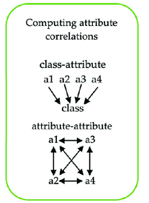
Filter Method - Evaluation Objectives
1- Classification-Driven:
High correlation with the output (objective function based on dependence measures)
Low correlation with other features (objective function based on dependence measures)
2- Information-Driven:
More informative (objective function based on information measures)
Correlation-based Feature Selection (CFS) is a feature selection technique that selects subsets of features that are highly correlated with the target variable but have low correlation with each other (no multicollinearity)

Slide 11
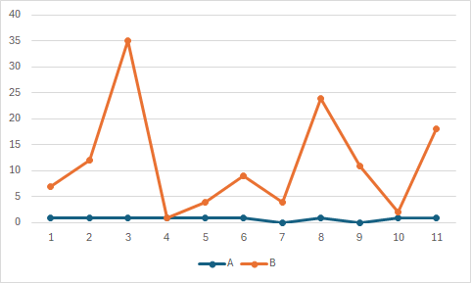
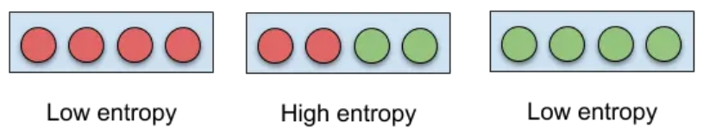
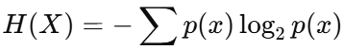
Objective Functions – Information Measures
Information measures quantify information content of a variable:
Variance threshold: to remove any features that have little variation in their values (below the threshold)
Shannon’s Entropy: the entropy of a variable presents the average level of information of the variable. If a variable have a little variety (less impurity) then entropy is low, if it contains high variety (more impurity) then entropy is high.
Low Variance vs High Variance Features
Shannon’s Entropy:

Slide 12
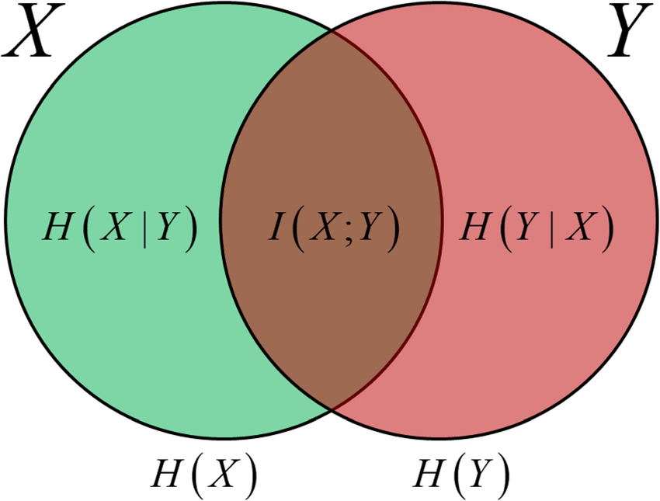
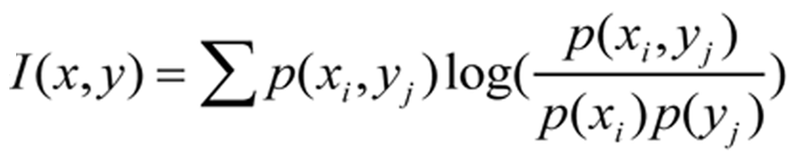
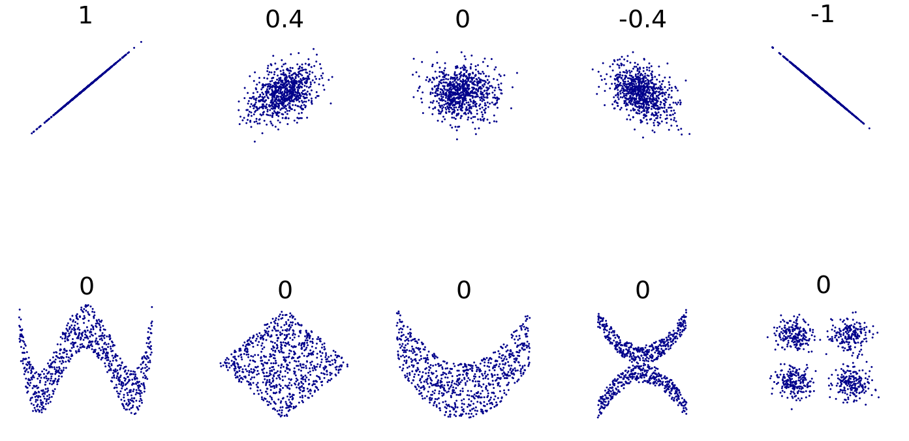
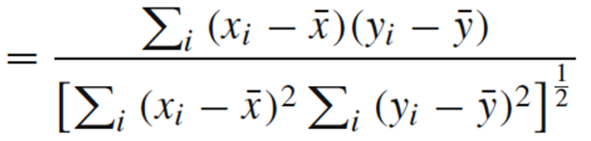
Objective Functions – Dependence Measures
Dependence measures quantify relationship between two variables:
Pearson’s correlation coefficient: Captures linear relationship
Mutual Information : The amount of entropy (information) that two variables share (captures both linear and non-linear relationships)
Chi-Square (categorical variables)
etc.
Mutual Information
Correlation Coefficient (r)

Slide 13
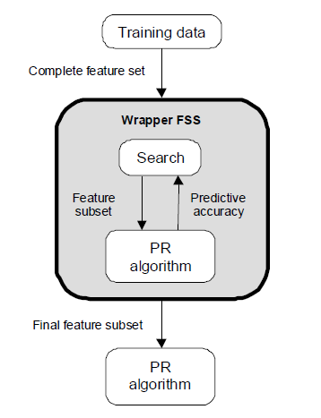
Evaluation Strategies– Wrapper Methods
Optimizes for a specific machine learning algorithm
Wrappers seek a subset of features that optimize classification / regression performance (objective functions)
Wrappers can be used even with unsupervised learning if an objective function is available (e.g., Silhouette in Clustering )
Typically, try to find the smallest size where adding more features does not improve objective function significantly. An improvement threshold can be used for this purpose

Slide 14
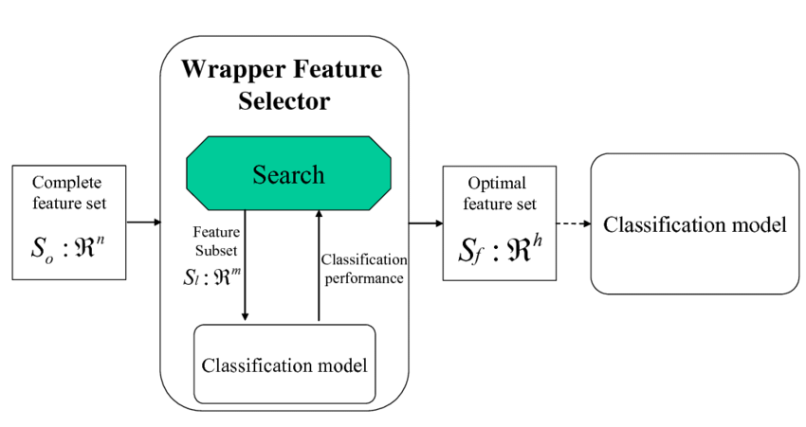
Wrapper Method - Steps
The feature selection is a wrapper around the learning algorithm:
Select a few subsets of features (Candidate Subset Selection)
Create training/validation sets for each feature subset
Train the model with each subset using training set
Evaluate performance (objective function) of each subset on validation set
Pick the subset with the best performance
Two Requirements of Wrapper Method:
Method of Candidate Subset Selection (Search Strategy)
Objective Function (Selection Criteria )

Slide 15
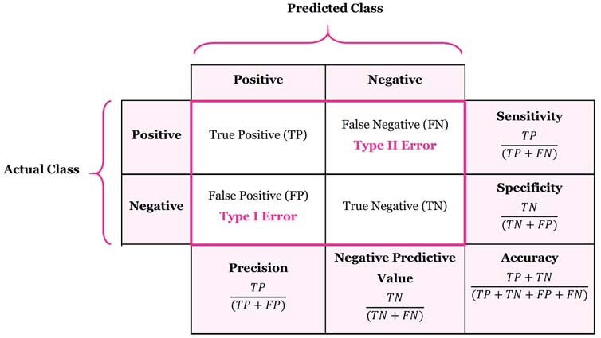
Objective Function
The objective function needs measures to quantify quality of feature subsets
Selection of measures depends on the application and the ML algorithm.
For wrapper methods these measures are model-driven (e.g., classification models)
The most common measure is prediction accuracy (using validation data)
For imbalanced datasets, AUC or F1-score are often more appropriate.
In some domains (e.g., health), sensitivity and specificity can be more relevant

Slide 16
Candidate Subset Selection - Naïve Search
Use each individual feature for classification.
Sort the features ordered by accuracy (or other objectives) of classification.
Select the top M features from this sorted list.
Advantage
Fast
Disadvantage
Best set of features may not be the set of best individual features.
Correlations between features (multicollinearity) are not considered
All Features: x₁, x₂, x₃, x₄
Rank of individual features by classification accuracy
x₄ , x₂ , x₃ , x₁

Slide 17
Search Strategies - Exhaustive Search
Exhaustive search generates all 2^{n} possible subset of n features
Each of these subsets should be used for training the model to be evaluated by the objective function
This evaluation is computationally expensive if many features exists in the dataset, since it needs training process
In such cases, it is more practical to use greedy approaches
Note: Sometimes the result of a greedy approach is not globally optimum
Example of Four Features – x₁, x₂, x₃, x₄
1,1,1,1
0,1,1,1
1,0,1,1
1,1,0,1
1,1,1,0
0,1,0,1
0,0,1,1
1,0,0,1
0,1,1,0
1,0,1,0
1,1,0,0
0,0,0,1
0,0,1,0
0,1,0,0
1,0,0,0
0,0,0,0
1: x_{i} is selected 0: x_{i} is not selected

Slide 18
Search Strategies - Greedy and Random Methods
Sequential Forward Generation (SFG)- Greedy
Start from an empty set and add a feature with best score (based on objective function)
Calculate score of each subset consisting of the current subset plus one remaining feature and select the subset with the best score (add feature causing most increase in accuracy)
Continue until there is no significant improvement or reaching desired number of features
Sequential Backward Generation (SBG) - Greedy
Start from a complete set of features
T Calculate score of each subset consisting of the current subset minus one of it’s features and select the subset with the best score (remove feature causing least decrease in accuracy)
Continue until dropping any feature causes a significant decreases in accuracy (or enough features)
Bidirectional Generation (BG) – Greedy
Begins the search in both directions, performing SFG and SBG concurrently
Stop when one search finds the best subset or both searches achieve the middle
4) Random Generation (RG)
The choice of adding or removing a features is a random decision.
RG tries to avoid the stagnation into a local optimal set

Slide 19
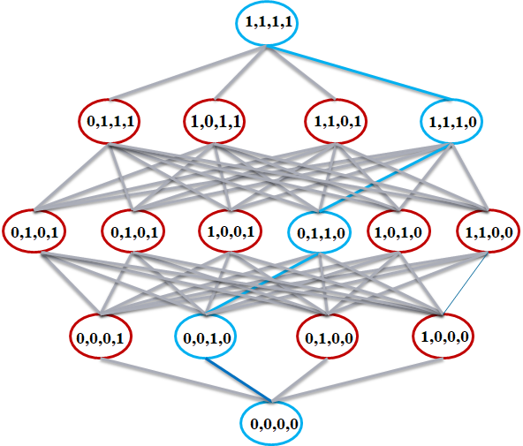
Forward Selection - Example
{x₁, x₂, x₃, x₄}
Stops if improvement is not significant
{x₂ , x₃ , x₁}
{x₂ , x₃, x₄}
J(x₂, x₃ , x₁)>=J(x₂, x₃, x₄)
J(x₂, x₃ , x₁) >> J(x₂, x₃) ?
{x₂, x₁}
{x₂ , x₃}
{x₂ , x₄}
J(x₂, x₃)>=J(x₂, x_{i}); i=1,4
J(x₂, x₃) >> J(x2) ?
{x₁} {x₂} {x₃} {x₄}
J(x₂)>=J(x_{i}); i=1,3,4
J: Objective Function
(e.g., Accuracy of the classifier)

Slide 20
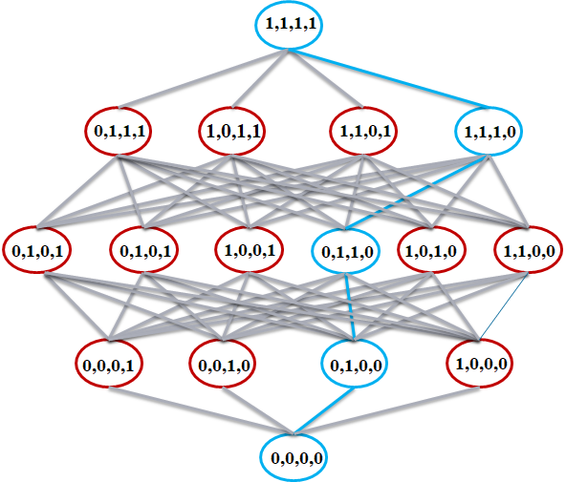
Backward Selection - Example
{x₁, x₂, x₃, x₄}
J: Objective Function
{x₂, x₃, x₄}
{x₁, x₃, x₄}
{x₁, x₂, x₄}
{x₁, x₂, x₃}
J(x₁, x₂, x₃) is maximum
J(x_{1,} x₂, x₃) ≈ J(x_{1,} x₂, x_{3,} x₄) ?
{x₂, x₃}
{x₁, x₃}
{x₁, x₂}
J(x₂, x₃) is maximum
J(x₂, x₃) ≈ J(x_{1,} x₂, x₃) ?
{x₂} {x₃}
J(x₂) is maximum
J(x₂) ≈ J(x₂, x₃) ?
Stops if decrease is significant

Slide 21
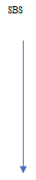
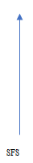
Bidirectional Selection - Example
J: Objective Function
{x₁, x₂, x₃, x₄}
Step2:
Consider all subset containing x2:
J(x₂, x₁, x₄) is maximum
x₃ is removed
{x₂, x₃, x₄}
{x₂, x₁, x₄}
{x₂, x₁, x₃}
Step 3:
Consider all subset without x3:
J(x₂, x₄) is maximum
x₄ is selected
Step 4:
Consider all subset containing x2 , x4:
Only (x₂, x₄) can be selected
{x₂, x₁}
{x₂, x₄}
Step 1:
J(x₂) is maximum
x₂ is selected
{x₁}
{x₂}
{x₃}
{x₄}

Slide 22
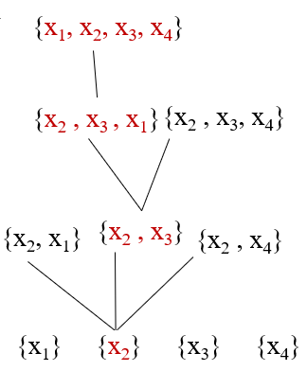
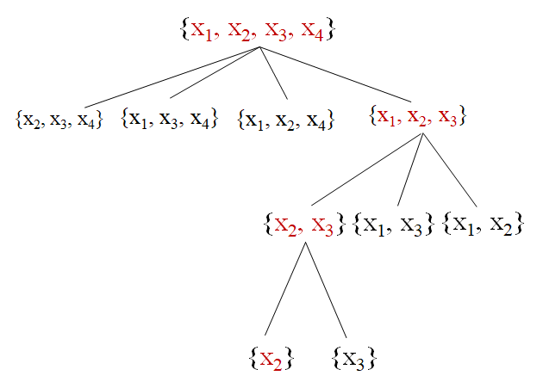
Heuristic Search Strategies Comparison
These algorithms are greedy; therefore, the results are locally optimum but not necessarily globally optimum.
Forward sequential selection is faster than backward sequential selection since it starts from smaller sets and doesn’t check most feature sets with large number of variables.
Backward sequential selection is more accurate than forward sequential selection since it checks more larger combinations of features.
Bidirectional sequential selection is more flexible than the other two techniques, but it can be more complex.

Slide 23
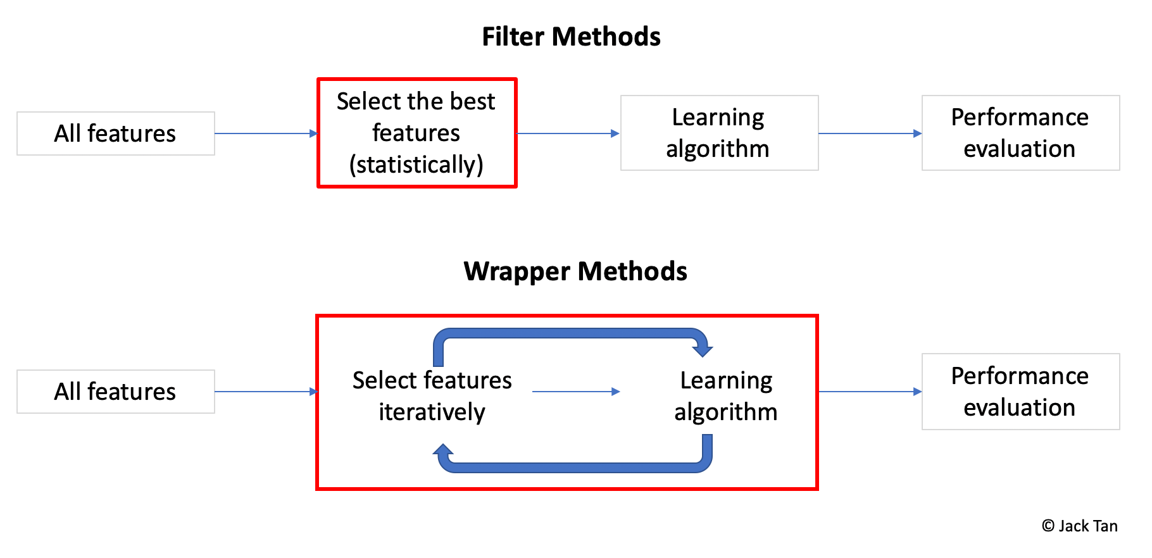
Filter vs Wrapper
Filter Approach
Advantages
Fast execution: Filters generally involve a non-iterative computation on the dataset, which can execute much faster than a classifier training session
Generality: Since filters evaluate the intrinsic properties of the data, rather than their interactions with a particular classifier, their results exhibit more generality and will be good for a large family of classifiers
Disadvantages
Tendency to select larger subsets comparing wrapper method
Wrapper Approach
Advantages
Accuracy: wrappers generally have better recognition rates than filters since they tuned to the specific interactions between the classifier and the features.
Disadvantages
Slow execution and computationally expensive
Risk of overfitting to a specific model (can use internal mechanism of the ML model to avoid overfitting)

Slide 24
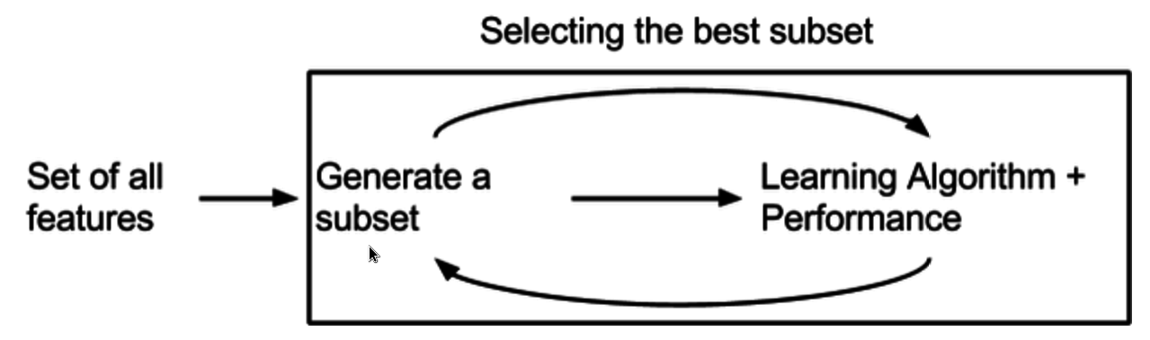
Evaluation Strategies – Embedded Methods
Embedded methods embed the feature selection procedure in the training of the predictive model :
The features are selected during the learning process.
Similar to the wrapper approach, features are specifically selected for a certain model
Achieve a faster solution by avoiding the re-training of a predictor for each feature subset explored.

Slide 25
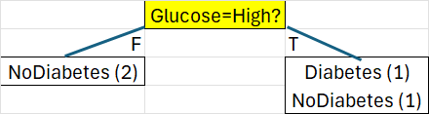
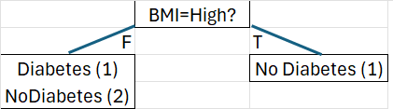
Embedded Methods - DTree
In training decision trees, the feature selection step is embedded inside the training process
At each node, the tree chooses the best feature using a criterion (e.g., Gini) to measure how well the split reduces impurity.
The algorithm also quantifies importance of each feature in splitting the classes using the importance scores.
The importance score of a feature measures its overall contribution to reducing impurity across the whole tree.
By training a decision tree, it calculates importance scores of all features directly.
from sklearn.tree import DecisionTreeClassifier dt = DecisionTreeClassifier(criterion="gini") dt.fit(train_feat, train_label) # Get importance scores print(dt.feature_importances_)

Slide 26
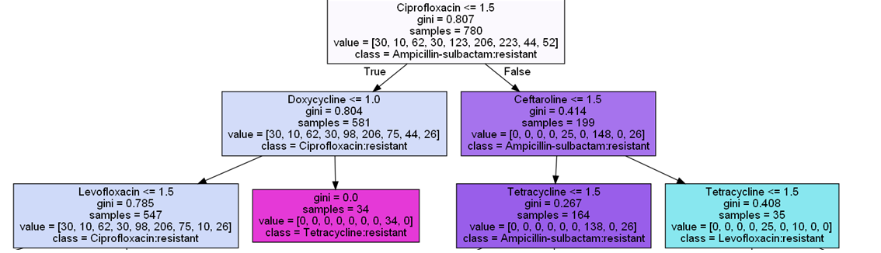
Importance Scores – Calculation Steps
During training a decision tree model:
For each split in the tree, calculate the impurity decrease (Gain) :
Gain (split) = Parent impurity – weighted average of child impurity
The feature used for the split gets importance score for the impurity decrease proportional to number of datapoints :
Score (split) = (Number of datapoints / Total number of datapoints) * Gain(split)
By aggregating scores for all splits in the tree, importance scores of each feature can be calculated and normalized :
Score (Feature) = Sum Scores by Feature / Total Scores by All Features

Slide 27
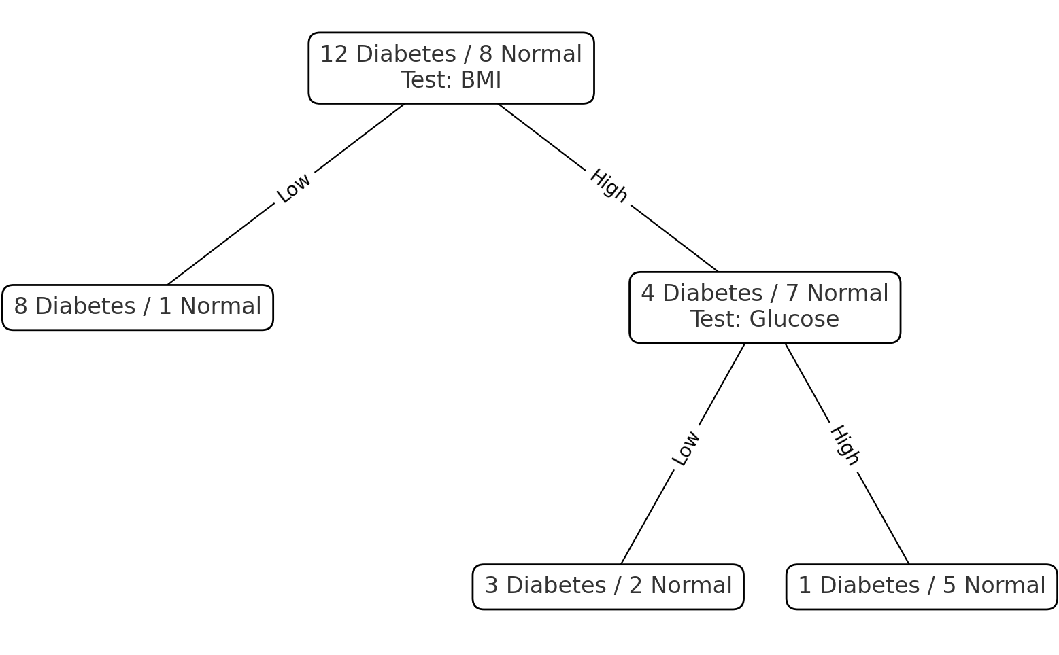
Importance Scores - Example
Misclassification (Mis) is used to quantify impurity:
First Split: BMI
Parent: Mis=8/20=0.40
Left child : Mis = 1/9 Right child: Mis = 4/11
Weighted Average= 9/20*(1/9) + 11/20*(4/11)=0.25
Gain(Split1) = 0.40 − 0.25 = 0.15
Score (Split1)= 20/20 * 0.15 = 0.15
Second Split: Glucose
Parent : Mis= 4/11 = 0.364
Left child : Mis = 2/5 Right child: Mis =1/6
Weighted Average = 5/11*(2/5) + 6/11*(1/6)=0.273
Gain(Split2) = 0.364 − 0.273 = 0.091
Score (Split2) = 11/20 * 0.091 = 0.050
Sum of Scores:
Sum of BMI Scores = 0.15
Sum of Glucose Score = 0.05
Normalized Scores (Score / Total Score):
BMI = 0.15 / 0.20 = 75%
Glucose = 0.05 / 0.20 = 25%

Slide 28
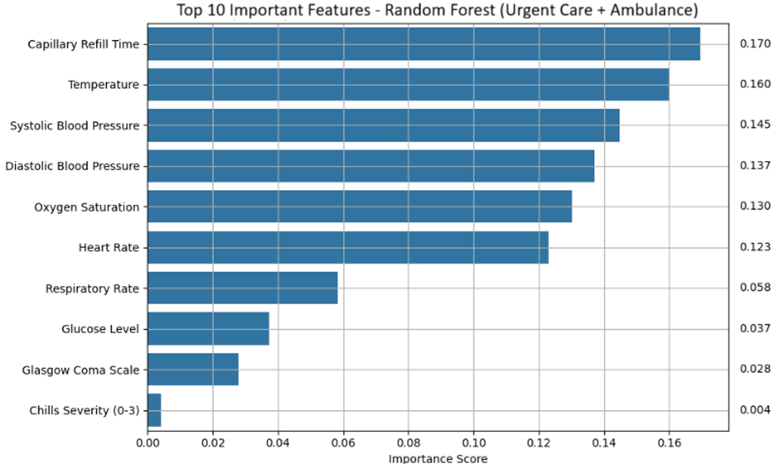
Importance Scores - Usages
Detect irrelevant features:
Low importance scores (close to 0) show irrelevant features which can be removed to make the model more robust (less noisy data and avoid C.D.)
Faster training with less features
Less overfitting due to reduction in complexity of model
Detect important features:
More interpretability (important features for prediction)
High-importance features might deserve further preprocessing
Feature engineering for other models:
Importance scores can guide feature engineering for other models

Slide 29
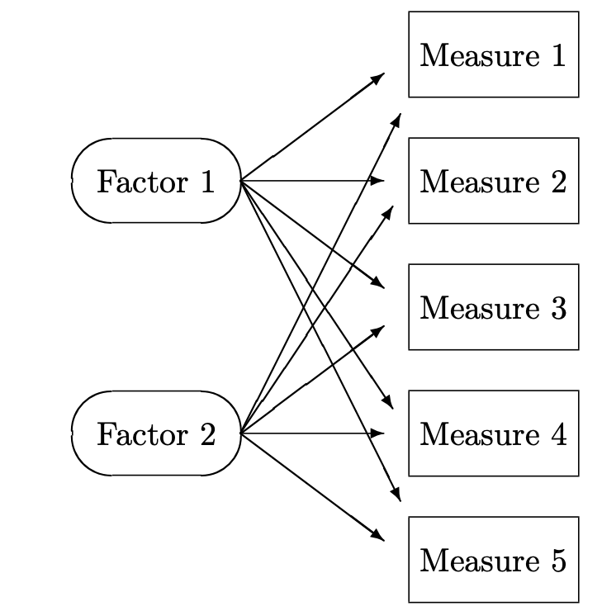
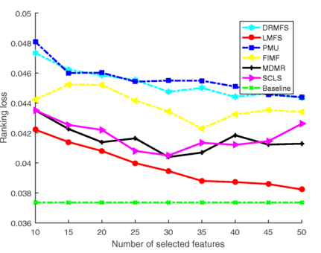
Feature Selection Drawbacks
Sometimes a large dimensionality cannot be reduced to a small subset without seriously effect the performance.
Presenting features in two or three dimensions is generally more convenient for visualization
Possible hidden factors cannot be identified using feature selection methods
Ranking loss comparison of different feature selection methods when KNN is used as the basic classifier (Yao Zhang)

Slide 30
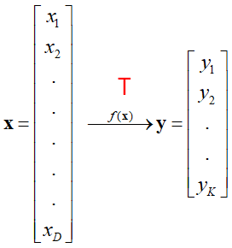
Feature Extraction (FE)
FE is a dimensionality reduction approach which creates new features from the original features
FE is a transformation (projection) from original dimensions to new dimensions
Finding an optimum transformation can be formulated as an optimization problem (i.e., minimize or maximize an objective function).
Common linear feature extraction methods:
Principal Components Analysis (PCA): Seeks transformation that maximize information preservation (info-driven)
Linear Discriminant Analysis (LDA): Seeks transformation that maximize class separability (class-driven)
Many other methods:
Making features as independent as possible -> Independent Component Analysis (ICA)
Preserving the structure of the data -> Uniform Manifold Approximation & Projection (UMAP)
Preserving the pairwise distances -> MultiDimensional Scaling (MDS)
Etc.

Slide 31
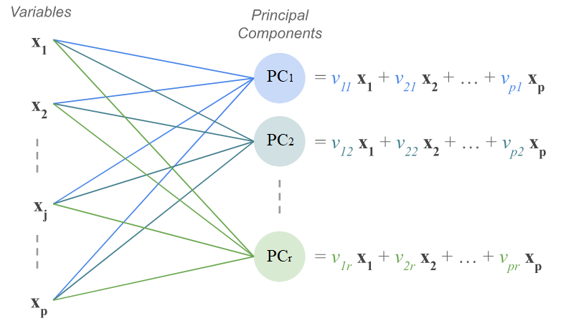
Principal Component Analysis (PCA)
Unsupervised approach (not classification-driven) to create new variables, principal components (PCs), from existing variables.
Principal components (PCs) are linear combinations of the original variables
PCs collectively try to maximally explain the variance (information-driven) of the original variables:
Each PC tries to explain most information (variance) of original features
Each PC tries to cover information (variance) which is not covered by other PCs (no correlation with other PCs)

Slide 32
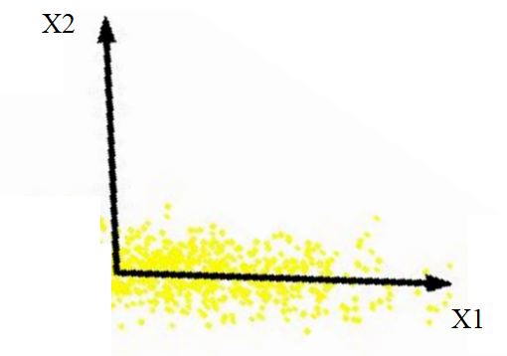
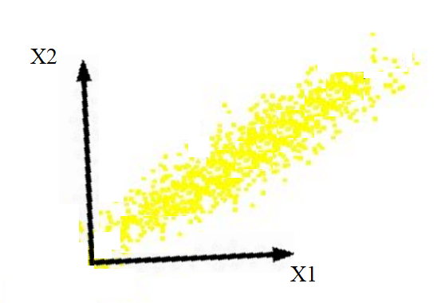
PCA – Idea
Most information (variability) is explained by X1
Information (variability) is explained by both X1 and X2
There is no correlation between x1 , x2
There is a correlation between x1 , x2
Intrinsically lower dimensional.
We can remove X2 without loosing many information (a good candidate for dimensionality reduction)
Removing X1 or X2 cause a main information loss
(Not a good candidate for dimensionality reduction)

Slide 33
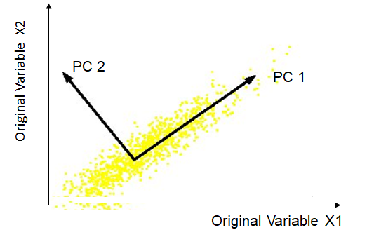
PCA - New Dimensions
Idea : Using correlations between two features, define a new variable (component) contains most of information (variability)
Both features contain some part of information (Variability)
Only one of new features (components) contains most of information (Variability)
There is a linear correlation between X1, X2
PC1 is aligned with the direction of covariance between x1,x2

Slide 34
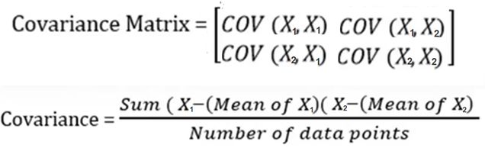
Covariance Matrix
Covariance measures how two dimensions (features) vary with respect to each other. It shows the linear relationship between two variables
Normalize data features so they have similar magnitudes else covariance may not be as informative
The directions of the covariance matrix capture linear correlations between original features
X1 X2
x2
X1
X2
x1
Problem: How can we recognize the directions of the covariance matrix?

Slide 35
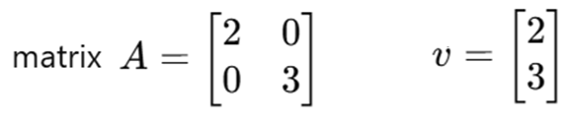
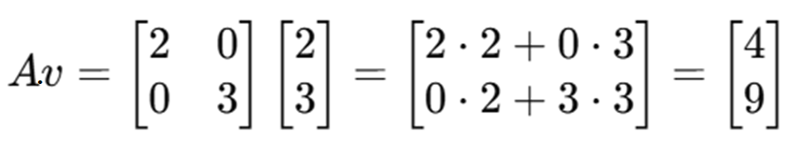
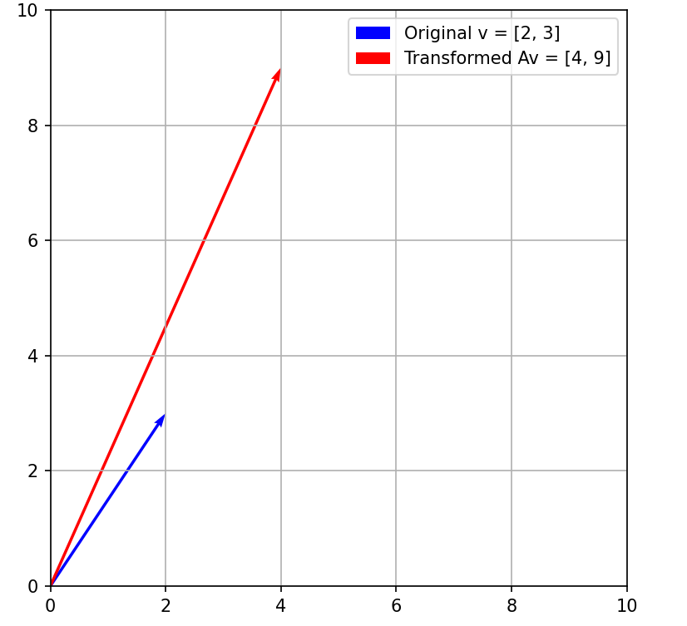
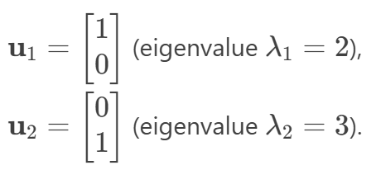
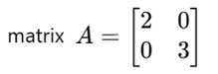
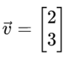
Eigenvectors – Direction of Transformation
A matrix can make a transformation to a datapoint by applying dot product
Example: matrix a transform datapoint v (two dimensions)
Eigenvectors represent the directions along which a transformation acts and eigenvalues the magnitudes of directions
X1
X2
X1
Eigenvectors
u2
u1
X2

Slide 36








Eigenvectors - Calculation
If a matrix transform its eigenvector, it doesn’t change the direction but may change the scale:
We can use this formula to calculate eigenvectors and eigenvalues
$$A{ u}_{i}=λ_{i}u_{i}$$
$→u (A {− λI)}_{}=0$ $→$ |A- $λI|=0$

Slide 37


Eigenvectors of Covariance Matrix
Eigenvectors of covariance matrix signify the directions of the new dimensions
Eigenvalues are proportional to the variance the new dimensions explain
PCA projects the data into new dimensions (direction of Eigenvectors).
The biggest eigenvalue represent the largest variance(most informative) the second biggest eigenvalue represent the second largest variance, and so on.
Eigenvectors of a covariance matrix (symmetric) are orthogonal (independent)
A is covariance Matrix
𝑢i are eigenvectors of A
𝜆𝑖 are eigenvalues of A
$$A{ u}_{i}=λ_{i}u_{i}$$
$A u=λ$ $u$
$u (A {− λI)}_{}=0$
|A- $λI|=0$ (determinant is zero)
u1: direction of max variance
u2: orthogonal to u1

Slide 38









Eigenvectors of Covariance Matrix - Example
Calculate the eigenvector and eigenvalues of the following dataset:
1- Calculate covariance matrix (A):
2-The eigenvalues of the covariance matrix can be calculated using :
$A u_{}=λ_{}u_{} \text{→}u (A {− λI)}_{}=0$ → |A- $λI|=0 \text{→}$
$\text{→}$ ($6.25\text{ −}λ) ∗\left(3.5\text{−}λ\right)−4.25∗4.25=0$
$$→$$

Slide 39










Eigenvectors of Covariance Matrix - Example
3- The eigenvectors of the covariance matrix can be calculate using:
Eigenvectors are typically normalized to have unit-length
$A u_{i }=λ_{i}u_{i }→u_{i }(A−$ $λ_{i}I$) = 0
$$u_{1 }$$
$(A−$ $λ_{1}I$)
$${ −3.09 u}_{11 }+{ 4.25 u}_{12 }=0$$
$${4.25u}_{11 }−{ 5.84 u}_{12 }=0$$
${ \sqrt{{ u}_{11 }2+{ u}_{12 }2}}_{}=1$
6.25-9.34 | 4.25
4.25 | 3.5-9.34
u11
u12
0
0
$$→$$
$$→u_{1= }$$
0.81
0.59
*
=
$$u_{2 }$$
$(A−$ $λ_{2}I$)
$${5.84 u}_{21 }+{ 4.25 u}_{22 }=0$$
$${4.25u}_{21 }+{ 3.09 u}_{22 }=0$$
$${ \sqrt{{ u}_{21 }2+{ u}_{22 }2}}_{}=1$$
6.25–0.41 | 4.25
4.25 | 3.5- 0.41
*
u21
u22
=
0
0
$$→$$
$${→u}_{2= }$$
-0.59
0.81

Slide 40

PCA Algorithm Steps
Normalize features to transform them to the same scale
Calculate the covariance matrix of the normalized features
Calculate the unit eigenvectors and eigenvalues of the covariance matrix
Keep p (< original dimensions) eigenvectors with the largest eigenvalues
Matrix multiply the p eigenvectors with the centered data to transform data to only p features
Number of PCs is equal to number of original features
But the first PC will be most informative and second one will be the second most informative and so on…

Slide 41

PCA Example – Psychoneurosis Symptoms
Symptom Scores ( from 1 to 7)
Patient 1
Patient 2
Patient 3
Patient 4
Patient 5

Slide 42




PCA Example – Normalizing

Slide 43


PCA Example – Covariance Matrix
COV(F2,F3) = ((0.816)(0) +
(-1.633)(1.603) +
(0)(0) +
(0)(-1.069) +
(0.816)(-0.534)) / 5
= -0.607

Slide 44

PCA Example – Calculation of Eigenvalues
det(A- λI) = 0
A- λI =
det(A- λI) = 0 → λ = 2.11691 , 0.855413 , 0.481689 , 0.334007
Larger eigenvalues indicates more coverage of variance

Slide 45

PCA Example – Calculating Eigenvectors
Av = λv → (A-λI)ν=0
λ = 2.11691 , 0.855413 , 0.481689 , 0.334007 (ordered)
For λ = 2.11691, the eigen vector is:
0.515514
0.441098
0.399314
-0.616625
Regarding λ we select
E1 and E2 which explain most variances
Most Important Component
Second Important Component

Slide 46



PCA Example – Transform to New Features
Normalized Dataset * Selected_eigenvectors → Transformed Dataset
PC1 PC2
←
*

Slide 47
PCA Example – Interpretation of PCs
Original Data
Eigen Vectors
E1->PC1 E2->PC2
F1
F2
F3
F4
PC1 = Highly correlated directly with F1,F2,F3 and indirectly with F4 → Autism ?
PC2 = Highly correlated directly with F1 and indirectly with F4 → ADHD ?

Slide 48

PCA vs Factor Analysis
Factor analysis explicitly assumes the existence of hidden factors underlying the observed data.
PCA seeks to create variables that are composites of the observed variables.
Although these techniques are different concepts, however, In most cases PCA is used as preliminary step for conducting factor analysis
The PCs are data-driven, not theory-driven, therefore, sometimes PCs are difficult to interpret

Slide 49

Optimal Number of Selected PCs
Number of components is the same as number of the original features
The first components have most of the information
The last components can be removed without losing significant information
1,2,3 - > A few first components can be selected as the new set of features
Problem: How many components?
Solution: Three common methods:
the Kaiser rule
the visual examination of a scree plot
the variance explained criteria
https://pubs.sciepub.com/wjoc/3/1/4/figure/7

Slide 50

Individual Assessment of PCs
Kaiser-Guttman criterion (Kaiser’s Rule ):
Principal components are retained whose eigenvalue exceed 1.
The idea is that any principal with variance less than 1 contains less information than one of the original variables and so is not worth retaining.
Problem: Sometimes the variance covered by the Kaiser rule is not enough.
Example: λ = 2.11691 , 0.855413 , 0.481689 , 0.334007
2.11691 / 3.78 = 56%

Slide 51


Cumulative Assessment of PCs
The visual examination:
Decide which PCs to retain using the elbow point where the explained variance levels off
The variance explained criteria:
set a threshold (e.g., 90%) and stop when the first k components account for a percentage of total variation greater than this threshold
First 2 PCs covered 87% of variability
First 3 PCs satisfy 90% threshold
Problem:
If there are no strong linear correlations between features, the PCs might not be very informative: e.g., λ1: 1.2 , λ1: 0.9, …

Slide 52

PCA Application in Images Processing
Goal: represent face images in a space of lower dimensionality using PCA.
Each face image is treated as a datapoint and pixels as features
Eigenfaces are the eigenvectors of the covariance matrix of a face image
Approximate a face image using K largest eigenvectors (Eigenfaces)
K largest eigenvectors
Captures major facial information
Efficient Representation
Useful for various applications, e.g., face recognition, image compression, etc.
y₁
y₂
y₃
Weighted sum of eigenfaces can create an approximate rendering of the face.

Slide 53



PCA Application in Visualization
Visualizing high-dimensional data (more than 3 dimensions) can be challenging
Feature extraction techniques are powerful tools for reducing dimensions to 2D or 3D for visualization
Information-driven methods like PCA are better for visualizing data since the goal is to preserve as much as information as possible

Slide 54

PCA Limitations
PCA is looking for best directions to explain most variance (Information-driven)
Problem: Direction of most variance is not always optimal for classification purposes
Best class distinction
Best Variability

Slide 55

Linear Discriminant Analysis (LDA)
A supervised technique seeks to find linear transformation which the classes are best separated (i.e., find more discriminatory features).
projection direction
projection direction
Bad separability
Good separability

Slide 56




LDA - Method
LDA transforms features to a space which maximizes their between-class separability while minimizing their within-class variability.
The main objective of LDA is to find a transformation (projection) that maximises the ratio of the determinant of S_{b} to the determinant of S_{w} (Fisher’s criterion) :
Distance of average of classes
Distance of datapoints from average of classes
Using the following equation, we can find eigen vectors of u which are columns of transformation matrix:
Good Transformation Bad Transformation

Slide 57
LDA Steps
Compute the mean values for each class
Compute the scatter matrices (Sb, Sw)
Compute the eigenvectors and corresponding eigenvalues for the following equation:
Sort the eigenvalues and choose those eigenvectors with the largest eigenvalues to form a transformation matrix
Transform the data onto the new feature space.

Slide 58

PCA vs LDA
LDA is more effective than PCA for classification
PCA is more effective than LDA for preserving information
LDA is supervised; Therefore, we need labels to use LDA
PCA is unsupervised and can be used without labels
Both PCA and LDA are linear combination of features

Slide 59


Non-Linear Feature Extraction – Kernel PCA
Linear feature extraction methods can only capture linear relationships between features, but most real-world relationships are non-linear:
PCA is a linear dimensionality reduction method
Kernel PCA extends PCA to capture non-linear relationships between features
A function (kernel) maps the data into a high-dimensional feature space, then PCA combines those features.
Example: Suppose there are two features house price (X2) and house size (X1) and the relationship is not linear: A polynomial kernel can transform feature X1 to a new feature X’1 (e.g., ${X′}_{1}=$2$X_{1}+3{X_{1}}^{2}$) which is linearly correlated with X2 then PCA extract PCs from X’1 and X2

Slide 60

Kernel PCA - Advantages and Challenges
By choosing different kernels (RBF, polynomial, sigmoid), it can tailor the projection to the various structures of data.
Requires transformation of data using the kernel which can be computationally expensive for large datasets.
Needs a suitable kernel and hyperparameter tuning (e.g., using validation data )
Non-linear extracted features are less interpretable.
Complex kernels and small datasets increase risk of overfitting
There are many other non-linear feature extraction methods such as: Autoencoders, MDS, UMAP, etc.
LDA can also be used with kernels

Slide 61


Feature Creation - Knowledge Features
Knowledge features derived by combining or transforming features using formulas from specific domains rather than feature extraction methods
These features often carry more predictive power and interpretability because they encode relationships using important measures in the domain
Knowledge features reduce dimensionality by replacing multiple raw features with one meaningful feature using linear or non-linear combinations
Examples:
Healthcare: $\text{BMI}=\text{Weight}/{\text{Height}}^{2}$
Finance: Price-to-Earnings (P/E) = $\text{Stock} \text{Price}/\text{Earnings} \text{per} \text{Share}$
Marketing : Customer Lifetime Value (CLV) =(Average Order Value × Purchase Frequency × Customer Lifespan) − Acquisition Cost

Slide 62

Feature Engineering
Feature engineering is the process of transforming raw data into features that better represent the underlying problem to predictive models:
Feature Creation: e.g., knowledge features, aggregating features
Feature Transformation: e.g., binning , normalizing, encoding
Feature Selection: e.g., filter, wrapper, embedded
Feature Extraction: e.g., PCA, LDA
Feature engineering is one of the most important steps of data preprocessing
Good features are often more important than the algorithm in performance of the prediction model

Slide 63

Best Practices
Understanding the data : Perform exploratory data analysis (EDA) using statistics and visualizations before engineering features.
Data Cleansing: remove noises, outliers, impute missing values, etc.
Feature Creation: Derive meaningful knowledge features and aggregated features based on domain knowledge.
Feature Transformation: Encode, normalize, and transform features if needed
Feature Selection: Start with filter methods to remove irrelevant features. Apply wrapper methods if the remaining number of features is relatively small.
Feature Extraction: Use feature extraction for highly correlated features (multicollinearity) or high-dimensional data.
Evaluation: Always evaluate the model with the engineered features on validation data to analyze the effect on performance and avoid overfitting.

Slide 64

Assignment 6
Use world_ds.csv dataset containing socio-economic variables (features) of different countries and corresponding development_status as outcome (label).
Employ forward wrapper method to select best three features from the dataset.
Use a PCA model to create three new components from existing features.
Explain each PC (new features) based on the correlations with old features.
Use an LDA model to create two new components from existing features.
Compare the accuracy of KNN classifiers (K=9) trained on each set of features obtained using forward, PCA and LDA methods.

